Slide 1
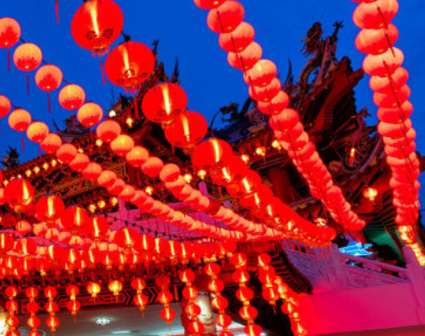
Neighborhood Recommendation Analysis of a New Chinese Restaurant in Downtown Toronto
By Anthony Yang

Slide 2
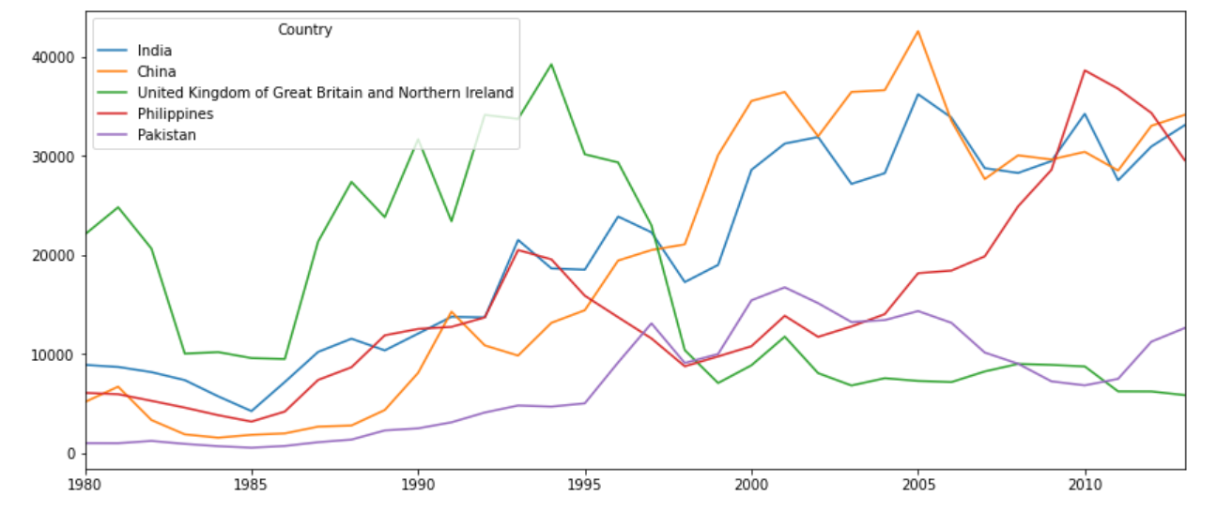
Introduction to business problem
Position
Competition
Neighborhood
Rating
Number of people from Top 5 countries immigrate to Canada
Data Source: International migration flows to and from selected countries - The 2015 revision by United Nations
With China became the No.1 Country to send immigration to Canada, open a Chinese Restaurant in Toronto is one of the realistic choices to make a living especially for the elderly generation
The question is,
Where exactly in Downtown Toronto should they open a Chinese Restaurant?
What is the Chinese restaurant market of downtown look like?

Slide 3
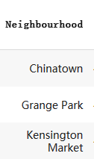
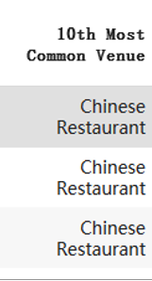
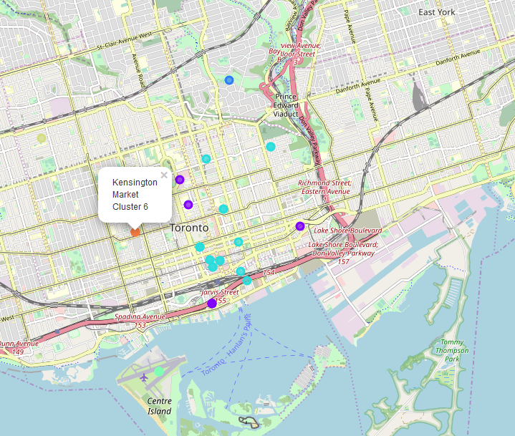
k-means clustering result
Using the k-means clustering with the data from Foursquare to explore the neighborhoods of downtown Toronto, the cluster 6(cluster 7 in report cause the cluster start at cluster 0) shows a good potential of the Chinese restaurant position
Cluster 6 is the only Cluster with Chinese Restaurant as the Top 10 most common venue, which means the tastes of these neighborhoods lean to Chinese food

Slide 4
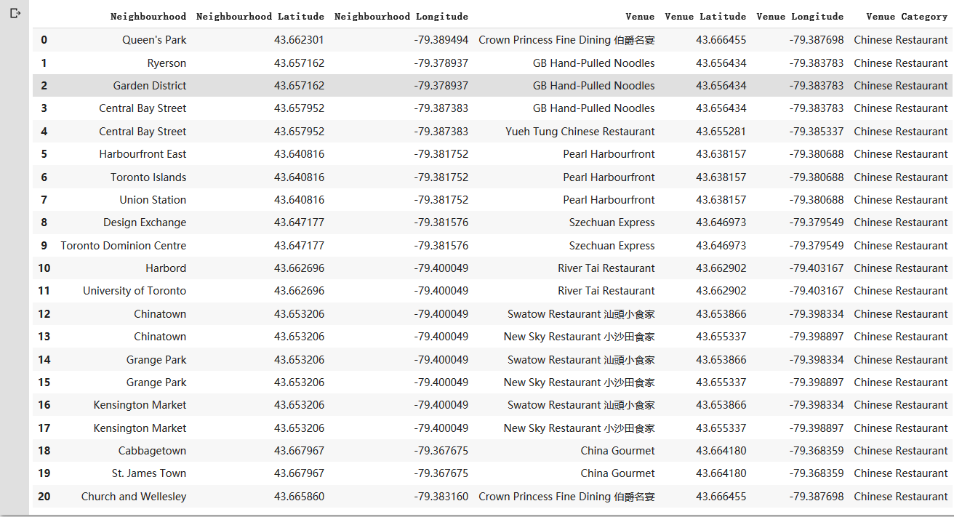
Detailed Chinese Restaurant Market Analysis of Downtown Toronto（1/2）
There are 20 different combinations between neighborhoods and Chinese Restaurant, and there are totally 9 Chinese restaurant in Downtown Toronto, some neighborhoods are expose to 2 Chinese Restaurant and others only expose to 1, the neighborhood not in this chart is expose to 0
Not every neighborhood in Downtown Toronto has Chinese Restaurant, let’s assume there is a reason: the citizen lived there don’t like Chinese Food, and maybe there used to be a Chinese Restaurant there but closed because of unsuccess business, so we only look at the neighborhoods with existing Chinese restaurant here

Slide 5
Detailed Chinese Restaurant Market Analysis of Downtown Toronto（2/2）
Then we got the ratings of these restaurant from Foursquare, here is the result, I assume the rating above 7.5 is Good, 7.0-7.5 is medium and below 7.0 is not good
Restaurant Name | Ratings | Ratings | Neighborhoods Nearby
Crown Princess Fine Dining 伯爵名宴 | 7.4 | Medium | Queen's Park
 |  |  | Church and Wellesley
GB Hand-Pulled Noodles | 7.9 | Good | Ryerson
 |  |  | Garden District
 |  |  | Central Bay Street
Yueh Tung Chinese Restaurant | 7.7 | Good | Central Bay Street
Pearl Harbourfront | 8.3 | Good | Harbourfront East
 |  |  | Toronto Islands
 |  |  | Union Station
Szechuan Express | 7.1 | Medium | Design Exchange
 |  |  | Toronto Dominion Centre
River Tai Restaurant | 6.6 | Not Good | Harbord
 |  |  | University of Toronto
Swatow Restaurant 汕頭小食家 | 7.7 | Good | Chinatown
 |  |  | Grange Park
 |  |  | Kensington Market
New Sky Restaurant 小沙田食家 | 7.7 | Good | Chinatown
 |  |  | Grange Park
 |  |  | Kensington Market
China Gourmet | 6 | Not Good | Cabbagetown
 |  |  | St. James Town

Slide 6
Recommendation:
The neighborhoods recommendation for people who have successful experience before and prefer the potential market size to open a Chinese Restaurant is Central Bay Street, Chinatown, Grange Park and Kensington Market.
The neighborhoods recommendation for people who don’t have much successful experience before and prefer the low competition environment to open a Chinese Restaurant is Cabbagetown, St. James Town, Harbord and University of Toronto
Market Size | Competition Level | Recommendation Neighborhood
Large | High | Central Bay Street, Chinatown, Grange Park, Kensington Market
Small | Low | Cabbagetown, St. James Town, Harbord, University of Toronto

